Slide 1


Data
Analysis

Slide 2


Today's agenda
Project recap
Problem
The Analytics team
Process
Insights
Summary

Slide 3


Project Recap
Social Buzz is a fast growing technology unicorn that need to adapt quickly to it's global scale. Accenture has begun a 3 month POC focusing on these tasks:
An audit of Social Buzz's big data practice
Recommendations for a successful IPO
Analysis to find Social Buzz's top 5 most popular categories of content

Slide 4


Problem
Over 100000 posts per day
36,500,000 pieces of content
per year!
But how to capitalize on it when there is so much?
Analysis to find Social Buzz's top 5 most popular categories of content

Slide 5



ANDREW FLEMING
Chief Technology Architect
The Analytics team
MARCUS ROMPTON
Senior Principal
YOU
Data Analyst

Slide 6

Process
1
Data Understanding
2
Data Cleaning
3
Data Modelling
4
Data Analysis
5
Uncover Insights

Slide 7


Insights
16
1897
JANUARY
UNIQUE
CATEGORIES
REACTIONS TO "ANIMAL" POSTS
MONTH WITH
MOST POSTS

Slide 8
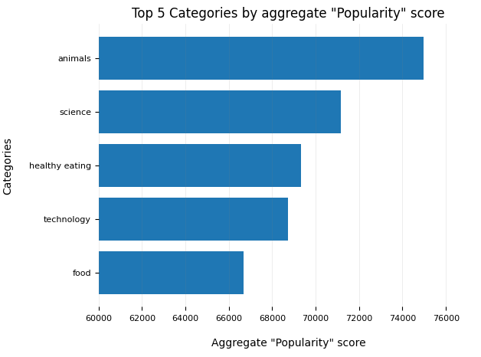

Slide 9
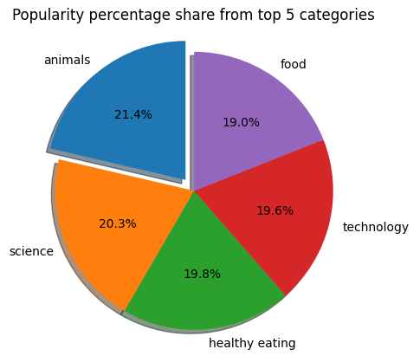

Slide 10


ANALYSIS
Animals and science are the two most popular categories of content, showing that people enjoy "real-life" and "factual" content the most.
INSIGHT
Summary
Food is a common theme with the top 5 categories with "Healthy Eating" ranking the highest. This may give an indication to the audience within your user base. You could use this insight to create a campaign and work with healthy eating brands to boost user engagement.
NEXT STEPS
This ad-hoc analysis is insightful, but it's time to take this analysis into large scale production for real-time understanding of your business. We can show you how to do this.

Slide 11

Thank you!
ANY QUESTIONS?

